Slide 1
2D Face Recognition
Part – 3
Ravitha N

Slide 2
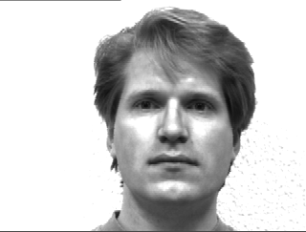
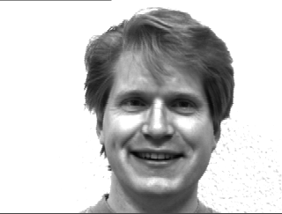


Elastic Bunch Graph Matching Techniques (distortion invariant representation)
Grid of k nodes is superimposed on a face
And features are extracted from each grid
Will Features will be similar ??

Slide 3




Reference Image
Test Image
During Matching face, nodes are moved until features corresponding to new position matches with
reference node features

Slide 4




Movement in the grid position

Slide 5
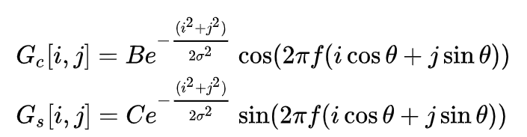


Procedure for Elastic Graph Matching
Training stage
Grid with k nodes considered
Node position is indicated as $x^{l}$
At each node position, M feature values are extracted using 2D Gabor Filter bank
$$f denotes frequency, θ denotes orientation, σ denotes the scale, B and C are normalizing factors$$
$$j\left(x^{l}\right)=\left[f_{1}\left(x^{l}\right),f_{2}\left(x^{l}\right)⋅⋯f_{M}\left(x^{l}\right)\right]$$

Slide 6
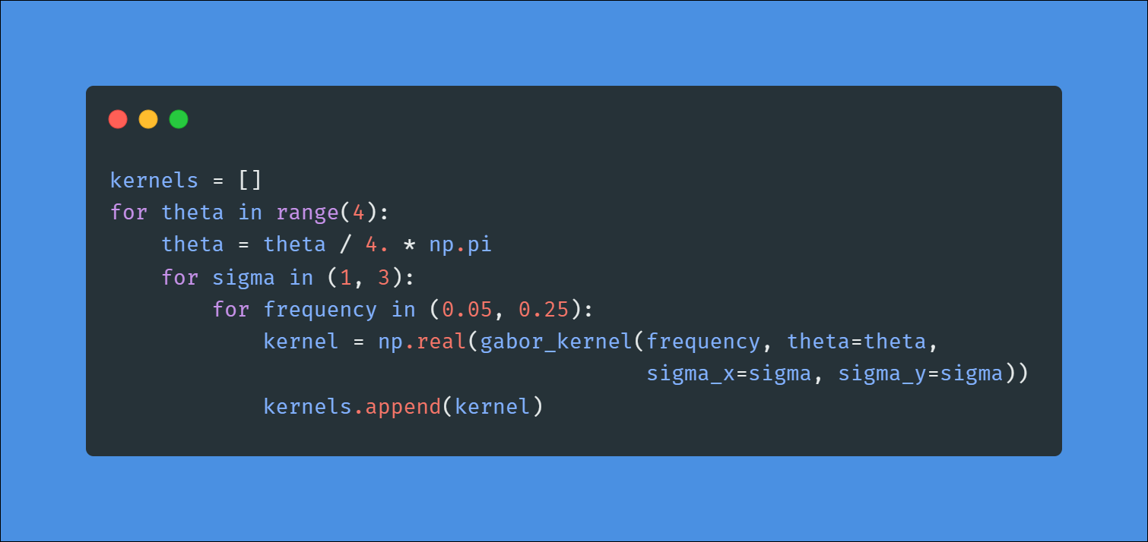
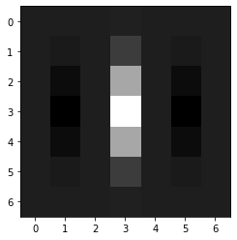
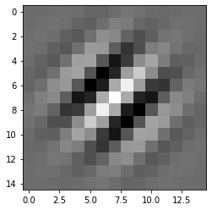
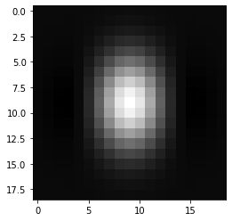
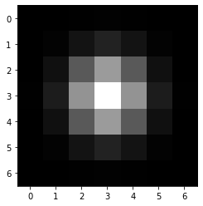
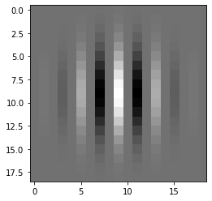

Slide 7
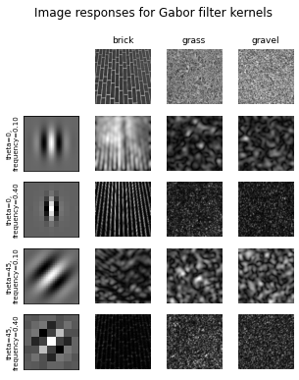
Reference:
https://scikit-image.org/docs/dev/auto_examples/features_detection/plot_gabor.html

Slide 8
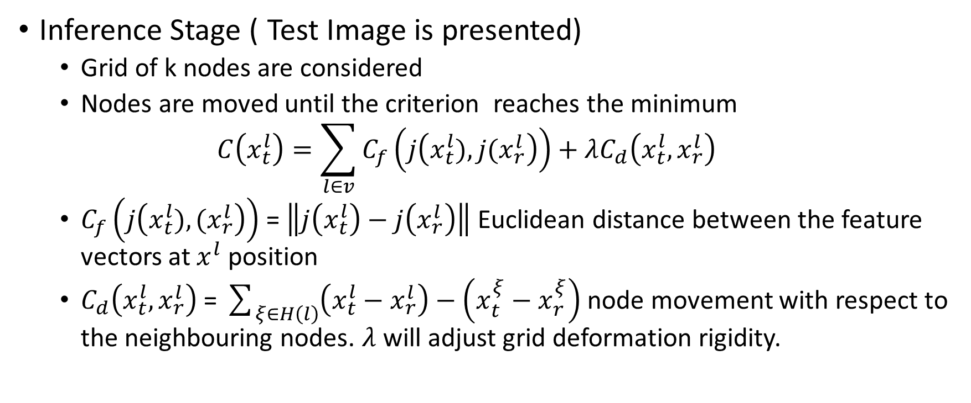
Procedure for Elastic Graph Matching
Inference Stage ( Test Image is presented)
Grid of k nodes are considered
Nodes are moved until the criterion reaches the minimum
$$C\left(x_{t}^{l}\right)=\sum_{l∈v}{C_{f}\left(j\left(x_{t}^{l}),{j(x}_{r}^{l}\right)\right)}+λC_{d}\left(x_{t}^{l},x_{r}^{l}\right)$$
$C_{f}\left(j\left(x_{t}^{l}),{(x}_{r}^{l}\right)\right)$ = $\left\|j\left(x_{t}^{l}\right)−j\left(x_{r}^{l}\right)\right\|$ Euclidean distance between the feature vectors at $x^{l}$ position
$C_{d}\left(x_{t}^{l},x_{r}^{l}\right)$ = $\sum_{ξ∈H\left(l\right)}{\left(x_{t}^{l}−x_{r}^{l}\right)}−\left(x_{t}^{ξ}−x_{r}^{ξ}\right)$ node movement with respect to the neighbouring nodes. $λ$ will adjust grid deformation rigidity.

Slide 9











Elastic Bunch Graph Matching
Node correspond to particular region in face. (eyes, nose and mouth)
For each analyzed image , a Gabor feature is associated with each node.
Node -> bunch of feature vectors
Vectors may characterize open , closed eyes
During inference stage, initial grid evolves
through Elastic Graph Matching Technique
Until the feature vector is close to those in
the bunches of FBG (Face Bunch Graph)
Face Bunch Graph

Slide 10
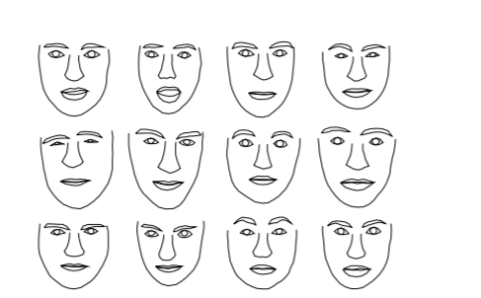
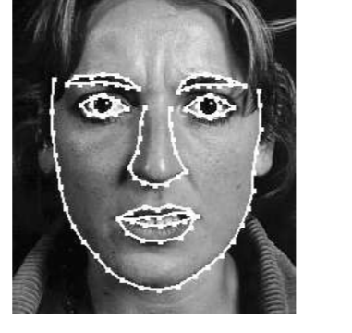
Hybrid Face recognition Technique
Combination of Local and Global recognition approach
Statistical shape model
Models a face image using set of coordinates that define the contour of a face
Using M face vectors corresponding to M face images, mean face shape is measured by aligning and averaging the shapes of considered face using Procrustes method

Slide 11
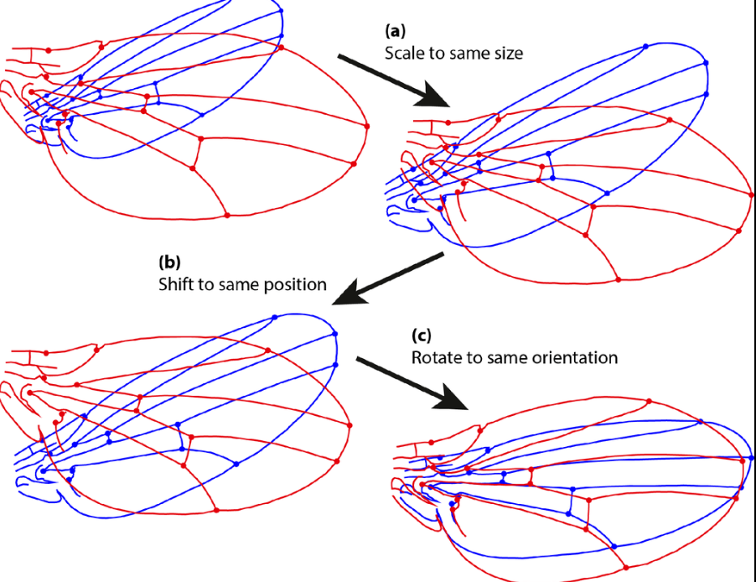
Procrustes Method
Translation
Rotation
Scale

Slide 12
Procrustes Method
Arbitrarily choose a reference shape (typically by selecting it among the available instances)
Superimpose all instances to current reference shape(eliminating, translation, scale and rotation components)
Compute the mean shape of the current set of superimposed shapes
If the Procrustes distance between mean and reference shape is above a threshold, set reference to mean shape and continue to step 2.

Slide 13
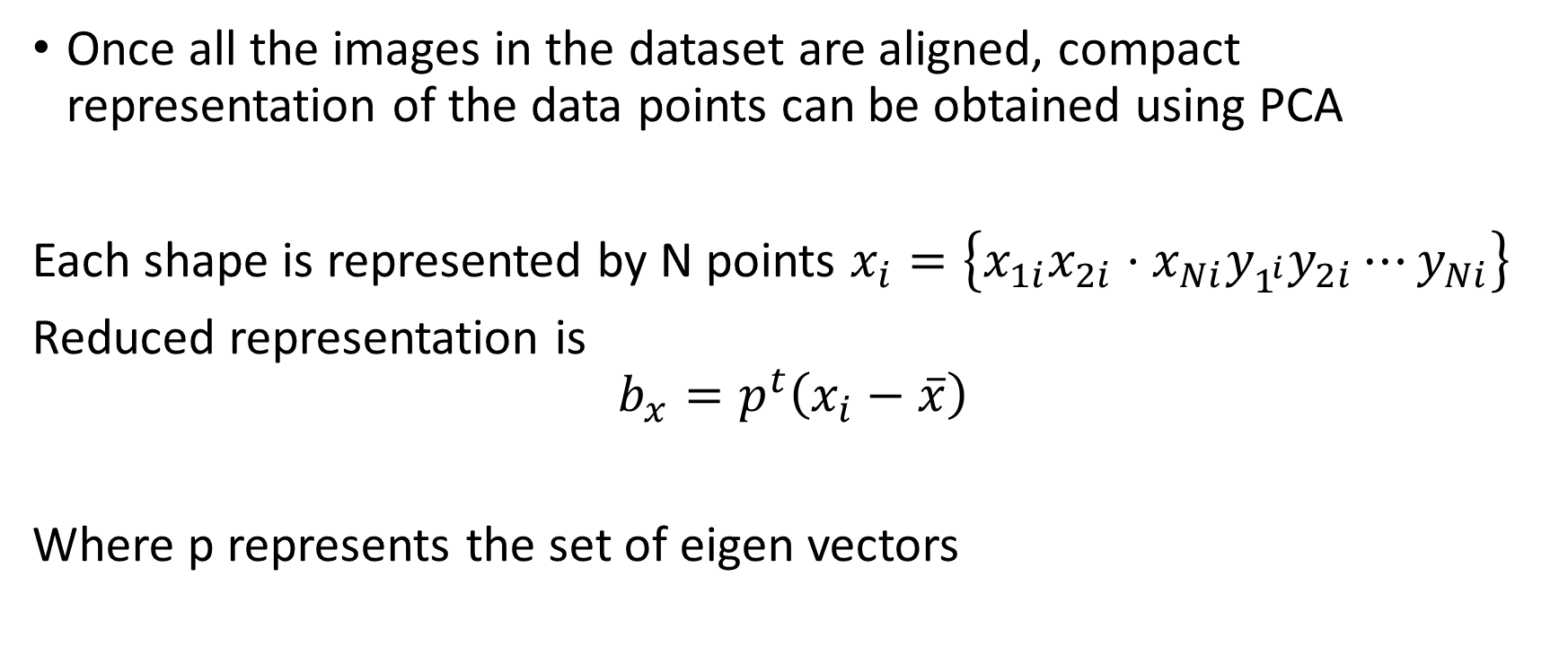
Active Shape Model
Once all the images in the dataset are aligned, compact representation of the data points can be obtained using PCA
Each shape is represented by N points $x_{i}=\left\{x_{1i}x_{2i}⋅x_{Ni}y_{1^{i}}y_{2i}⋯y_{Ni}\right\}$
Reduced representation is
$$b_{x}=p^{t}\left(x_{i}−\overline{x}\right)$$
Where p represents the set of eigen vectors

Slide 14
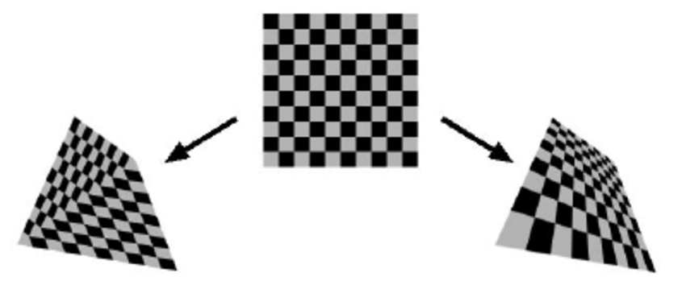
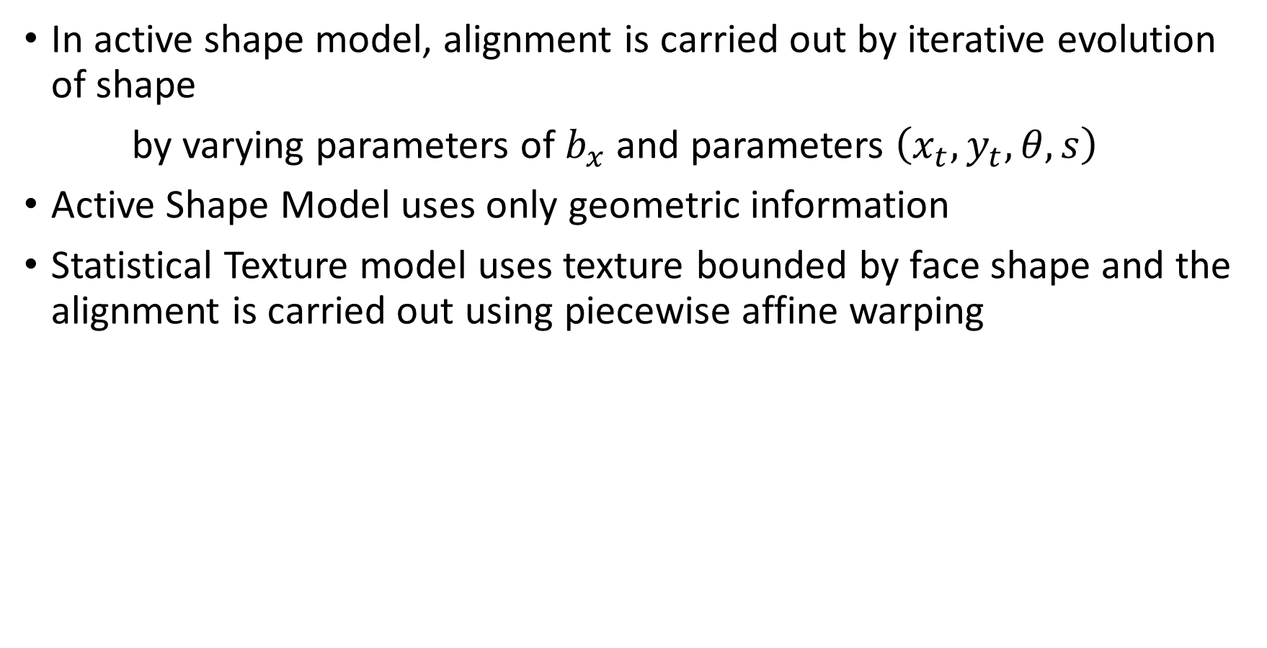
In active shape model, alignment is carried out by iterative evolution of shape
by varying parameters of $b_{x}$ and parameters $\left(x_{t},y_{t},θ,s\right)$
Active Shape Model uses only geometric information
Statistical Texture model uses texture bounded by face shape and the alignment is carried out using piecewise affine warping

Slide 15
Factors that affect the performance of Face recognition systems and Potential Solutions
Illumination
Lighting Variations
How to avoid? Obtain images in infrared domain
Pose
Use of EBGM and Multiview systems can greatly solve the problem
Occlusion
This problem is prevalent in video surveillance systems
Facial Expression
Active shape and Texture Models
Three dimensional Modelling
To characterize the depth information
Spoofing
Fake fingerprints
Liveliness Detection (Texture Analysis , eye blinking detection)

